Slide 1
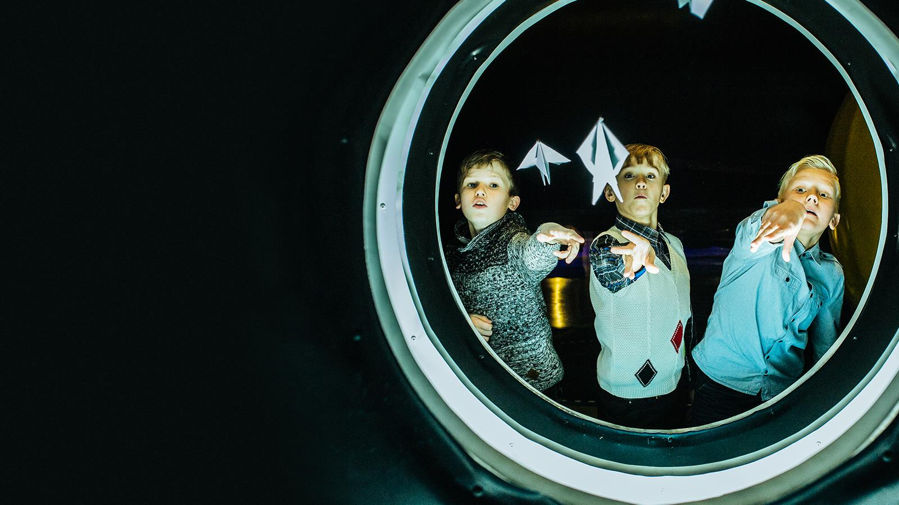
Tech Education
Estonia. Educating the next generation of innovators
Notes:
1

Slide 2



Estonian students top global rankings (PISA 2022)
1-2
6-7
in Europe
in math, reading
and science
in the world
in math, reading
and science
≈ 1.5 times more
top performers
vs OECD mean
≈ 2 times less
low performers
vs OECD mean
Notes:
PISA 2022. WORLD:
Math: 1)​ Singapore, 2)​ Macau (China), 3)​ Taipei (China), 4) HongKong (China), 5) Japan, 6) Korea, 7) Estonia
Reading: 1) Singapore, 2) Ireland, 3) Japan, 4) Korea, 5) Taipei (China), 6) Estonia
Science. 1) Singapore, 2) Japan, 3) Macau (China), 4) Taipei (China), 5) Korea, 6) Estonia
PISA 2022. EUROPE:
Math: 1)​ Estonia​, 510; 2)​ Switzerland​, 508; 3)​ Netherlands​, 493
Reading: 1) Ireland, 516; 2) Estonia, 511; 3) United Kingdom, 494
Science: 1) Estonia, 526; 2) Finland, 511; 3) Ireland, 504
Top and low performers. Estonia (vs OECD mean)
The share of TOP PERFORMERS:
-Reading 10% (vs 7%)
-Math 13% (vs 9%)
-Science 12% (vs 7%)
The share of LOW PERFORMERS:
-Reading 14% (vs 26%)
-Math 15% (vs 31%)
-Science 10% (vs 22%)
Source: https://www.oecd.org/publication/pisa-2022-results/country-notes/estonia-dafed886/
How did we get there?
MENTALITY: Aim-high-and-work-hard mindset​
AUTONOMY: Autonomy of schools and educators​
​ GOVERNANCE AND SOCIETAL SUPPORT: Evidence-based and equity-promoting governance, broad societal support for education​
​ DIVERSITY: Diverse and responsive school network​
EARLY CHILDHOOD EDUCATION: 94% of 4-6-year children attend kindergarten​
​ DIGITAL TECHNOLOGIES: Targeted investments, competences and tools​

Slide 3
Characteristics of
Estonia’s education system
AUTONOMY in schools:
Fostering innovation and flexibility
EDUCATION IS FREE OF CHARGE:
Ensuring equal access
to tech education opportunities
Emphasis on HOBBY EDUCATION: Nurturing interests in areas like technology
STRATEGIC PLANNING:
Goal-setting with stakeholders to guide Estonia's tech education journey
Notes:
AUTONOMY: Every school creates their own curricula on the basis on national curriculum. principals can decide on teachers salaries and how the money is spent etc, teachers are free to decide how they reach learning outcomes set in curricula
FUNDING: In general education, the state subsidy is related to the number of students, and covers expenses on teachers’ salaries, training, textbooks etc. Similar subsidies are also made available to private general education schools as prescribed by the Private Schools Act. Private schools comprise 11% of all schools.

Slide 4


Tracing the roots
The start of Estonia’s tech education revolution
1960
2004
2016–2017
Institute
of Cybernetics
EHIS
Estonian Education Information System
New computers
for teachers
1996
2002
2011
1988
Tiger Leap
E-School
Rakett 69.
TV show to promote
STEM education
First computers
type JUKU
reached schools
1968
2001
2016–2022
2012
First programming
lessons in 3 Estonian schools
All schools connected
to internet and provided with computers
Look@World Foundation
Modernizing internet connection
in all Estonian schools
IT Academy
ProgeTiger
Notes:
‘What might have been classed as a risky commitment to technology three decades ago has fostered a more progressive and open society, both online and offline.’ – Siim Sikkut, Estonia’s CIO 2017-2022

Slide 5







The Tiger Leap programme
in the 1990s provided schools with INTERNET CONNECTIONS, COMPUTERS, and IT TRAININGS.
All schools in Estonia
use E-SOLUTIONS.
The pillars
of Estonia’s
digital
education
DIGITAL LEARNING MATERIALS are available for all subjects and across all educational levels.
DIGITAL COMPETENCE
is set in curriculum
as a general competence.
For evidence-based decisions, the EDUCATIONAL DATA
is publicly accessible
on the internet.
Many schools and kindergartens
have EDUCATIONAL TECHNOLOGISTS
- technology integration specialists
to support teachers.
Educational programmes create INTEREST IN TECHNOLOGY from kindergarten to university.

Slide 6
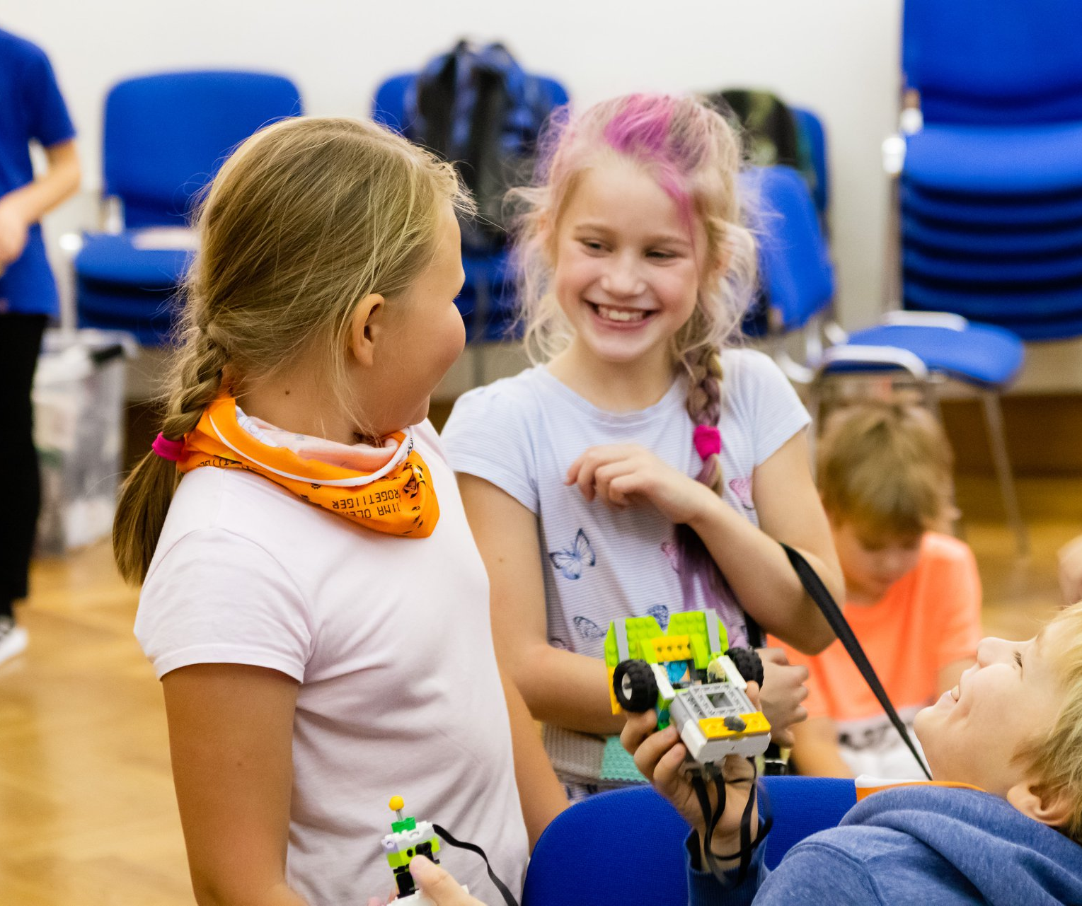
Early introduction to programming
ProgeTiger programme
Logical thinking, problem-solving skills,
creativity and innovation from kindergarten
to high school and vocational education
Teacher training, device funding support, student events, free educational resources
Notes:
FOCUS: Engineering, ICT, Design & Technology, Critical Thinking
GOAL: Understand Technology, Enhance Creativity & Problem-Solving Skills
TARGETING: kindergarteners to high school and vocational students
ACTIVITIES: Teacher training, device funding support, student events, and free educational resources

Slide 7
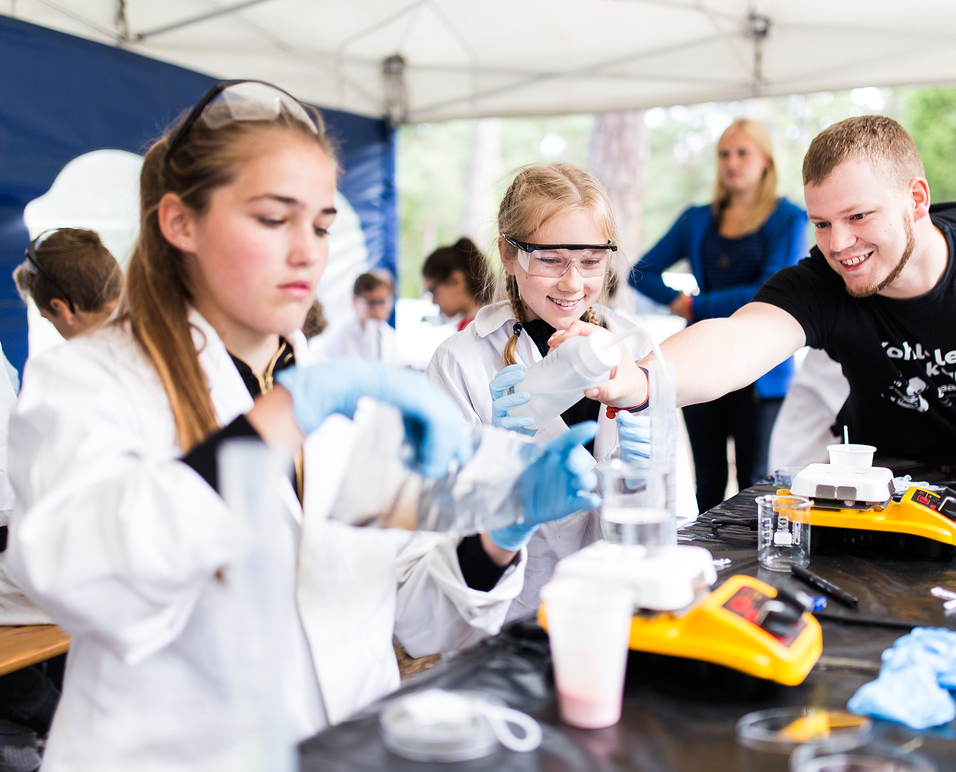
Challenging the brightest minds
Science school of
the University of Tartu
Educational opportunities
for gifted students:
Activities and resources
supplement the school curriculum
Competitions and student events
Learning materials
Notes:
Tartu University Science School aims to provide intellectually stimulating challenges to bright students. It offers systematic teaching across Estonia, supplementing the school curriculum with additional resources and activities. The school also organizes various competitions and events to engage students in scientific exploration.
Science School, University of Tartu : https://teaduskool.ut.ee/et
About: https://teaduskool.ut.ee/et/teaduskoolist

Slide 8
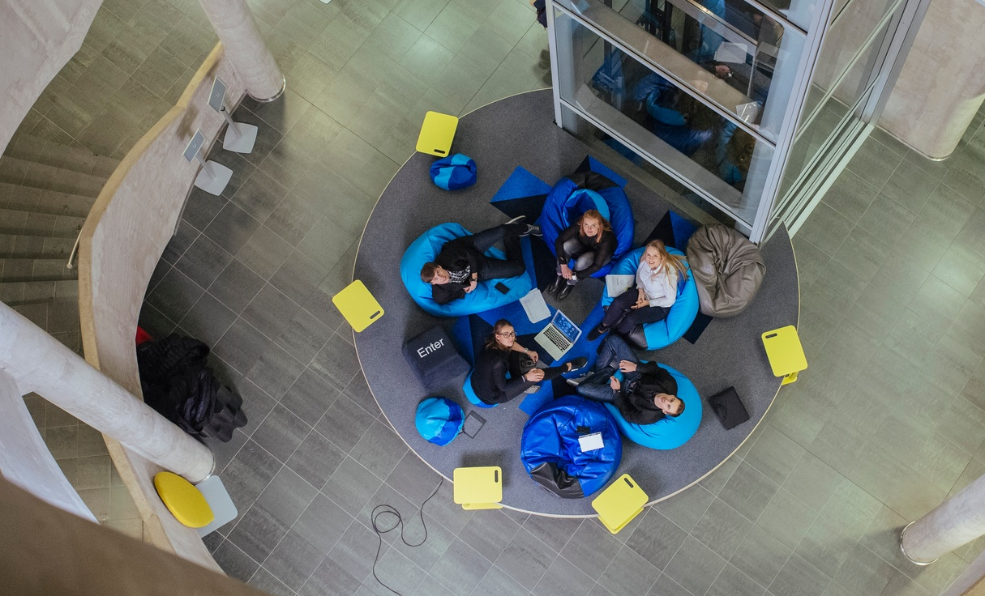
Hands-on tech
Informatics elective courses for high school
35-hour course for 10th and 11th-grade students
Involves defining problems, project planning, and execution
Teams of 3-5 students in different roles:
programmer, designer, project manager
Mentors from schools and companies
Notes:
DigiTaru is a 35-hour elective course in high school informatics where students work in teams to create solutions for real-world problems, mimicking professional software development cycles.
Teams consist of 3-5 students who have completed various computer science courses or have acquired necessary skills elsewhere.
Each team should have a school-based guide and preferably a mentor from the IT industry.
The project aims to teach students to create a prototype that solves a specific practical problem or need for a target group.
https://projektid.edu.ee/display/progetiiger/Digilahenduse+arendusprojekt

Slide 9
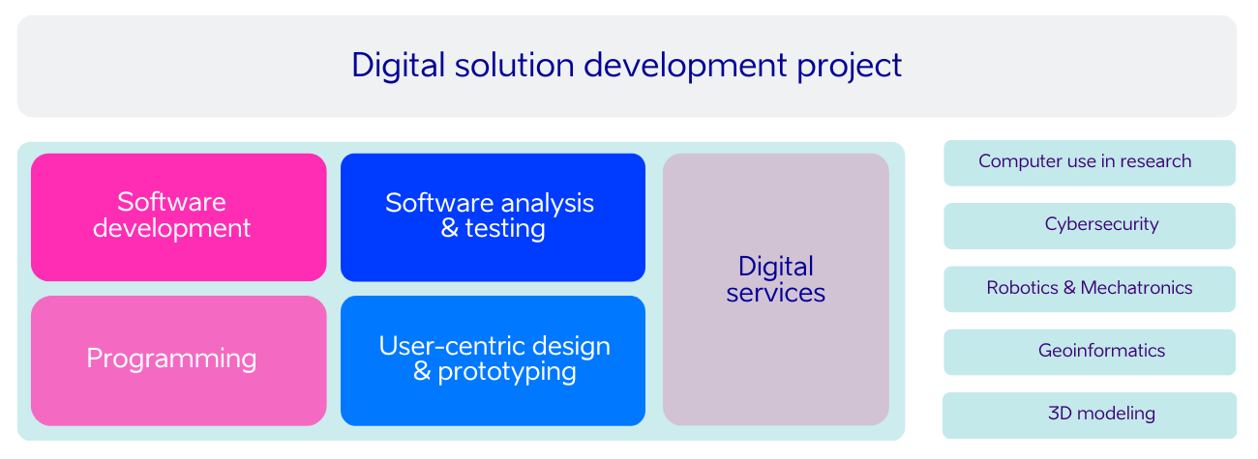
Hands-on tech
Informatics elective courses for high school
Notes:
NOTES: The course covers various subjects, including Software Development, Software Analysis and Testing, Digital Services, Programming, and User-Centric Design and Prototyping.
Additionally, students can enroll in pre-existing courses like Cybersecurity and Geoinformatics as part of this development project.

Slide 10
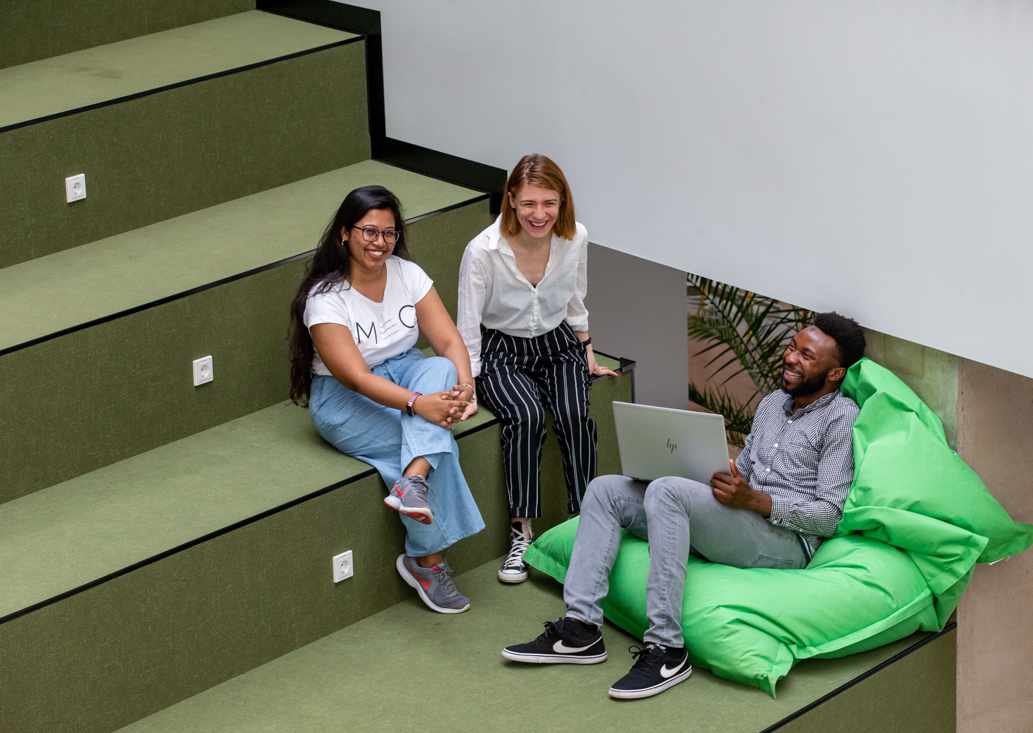
Shaping ICT education
IT Academy
A public-private partnership
for higher education in technology:
Cooperation programme between
the state, ICT companies, universities,
and vocational schools
Focus on ICT research,
higher and vocational ICT education
Ensures diverse ICT competencies
across various fields
Notes:
Innovative cooperation program between the state, ICT companies, universities, and vocational schools
Launched in 2012 to address the shortage of ICT professionals
Every ninth student in Estonia chooses to study ICT at the bachelor’s and applied higher education level
Focuses on the development of ICT research, higher ICT education, and vocational ICT education
Coordinated by the Education and Youth Board of Estonia

Slide 11
80% of the 7-19 year olds participate in hobby education and hobby activities
Notes:
11
Allikas: HM tulemusaruanne 2022 analüütiline lisa: https://www.hm.ee/sites/default/files/documents/2023-08/2022_TA_anal%C3%BC%C3%BCtiline_lisa.pdf

Slide 12
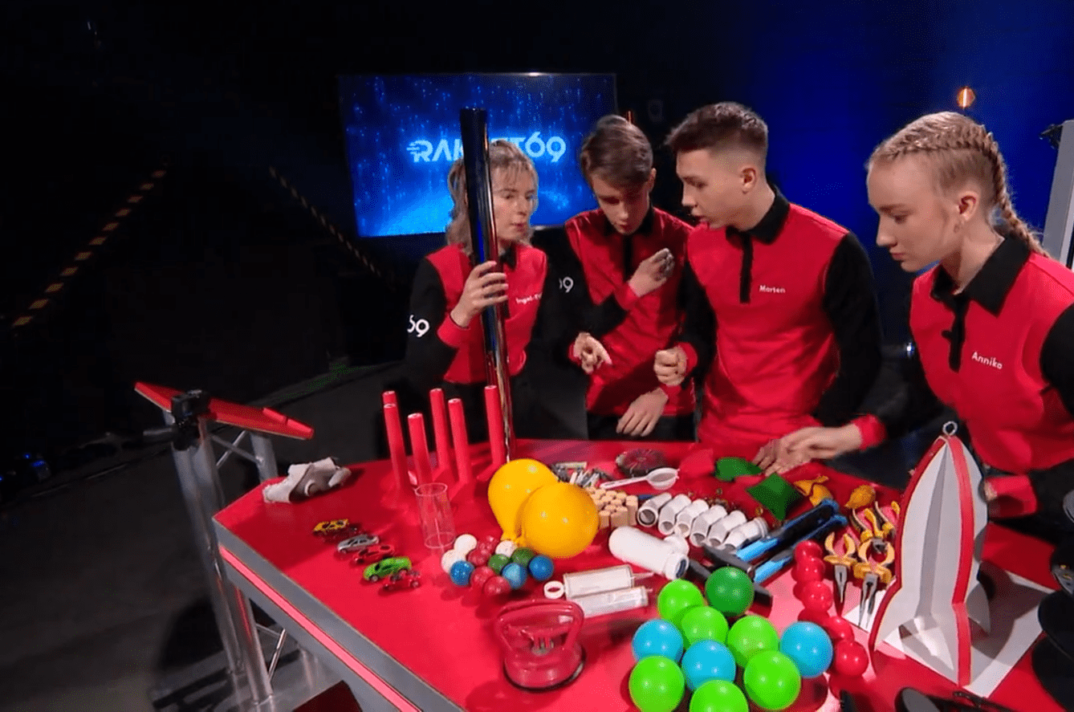
Making STEM popular
Rakett 69 TV show
Students from age 15 compete
for a €15,000 scholarship
Science tasks: electronics, robotics, chemistry
The show provides STEM teaching materials and lessons for schools
Notes:
established in 2011. Broadcast by Estonian Television and funded by the Estonian Research Council.
Fostering creativity, theoretical knowledge, and practical skills
Tasks often created in collaboration with tech companies
The show also provides STEM teaching material for schools
Has significantly contributed to the popularity of STEM in Estonia, with every third student pursuing higher education in the STEM field
Aims to popularize natural sciences among youth.
Contestants compete for a €10,000 scholarship.

Slide 13
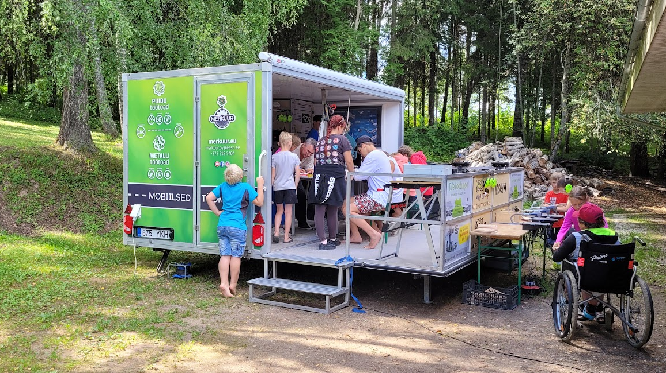
Estonian EdTechs
Private sector contributes to STEM education
PRAKTIKAL provides learning materials, experiment kits,
and software for a natural science learning experience.
MERKUUR offers mobile workshops for hands-on STEM learning.
FUTUCLASS provides immersive VR lessons for chemistry and physics.
Notes:
Praktikal, Merkuur, and Futuclass are examples of Estonian edtech companies that are contributing to the enhancement of STEM education. They offer innovative solutions that aim to bridge the gap between education and employment, make STEM learning more engaging and accessible, and leverage advanced technologies like VR to improve learning outcomes. These are just a few examples of the many Estonian EdTech companies working in the STEM field.
Praktikal: https://praktikal.ee/
Merkuur: https://www.merkuur.eu/
Futuclass: https://futuclass.com/

Slide 14

Empowering girls in tech
Unicorn Squad
Tech education for girls aged 8-14
Over 160 groups, 2000+ participants
Free course materials and instructions
Summer tech camps
Notes:
Unicorn Squad is a movement providing technology education specifically for girls aged 8-14. The aim is to increase girls' interest in technology, robotics, and natural sciences from an early age.
The initiative was launched in response to the underrepresentation of women in ICT fields, both in Estonia and globally. In Estonia, only about 22% of ICT specialists are women.
The program operates on the belief that girls are just as curious as boys, but often hold back in mixed groups, leading to a lack of positive experiences with technology. This can later reflect in the job market, where high-paying ICT jobs may seem inaccessible to them.
The Unicorn Squad has found that when girls can explore technology in girls-only groups, they are much more open, willing to experiment, and feel more comfortable. This approach helps to remove the fear of technology, boost their confidence, and increase their interest in technology, providing them with equal opportunities in the future job market.
As of spring 2023, the Unicorn Squad has over 160 groups with over 2000 girls participating across Estonia.
(Source: Unicorn Squad)

Slide 15

The numbers
Estonia’s tech education
99%
1in3
of Estonian kindergartens
take part in technology education programme ProgeTiger
students pursues STEM
in higher education
9%
40%
of students study ICT
in Estonia – twice as many as EU average
Eurostat 2018
of ICT Master’s students are female – this is highest share in Europe Informatics Europe 2020
Notes:
99% of kindergartens and 98% of schools took part in ProgeTiger programme, Education and Youth Board 2020
8.86% of all students studied ICT (BA+MA) in Estonia, while EU average is 4.65%, Eurostat 2018
2019/2020 40% of ICT Master students were female in Estonia, www.informatics-europe.org
1st in digital learning - CEPS (Centre for European Policy Studies) assessed European countries’ performance in digital learning and found that Estonia, the Netherlands and Finland excel in the digitalisation of education. www.educationestonia.org/estonia-no-1-in-europe-for-digital-learning/

Slide 16

Solving tech talent needs
Vali IT retraining programme
Intensive 14-week programme
Retrains non-tech professionals into tech roles
Acceptance rate 25%
700 specialists in 7 years
Notes:
IT Retraining for Non-Tech Professionals in Estonia
Vali IT! Program: An intensive 14-week program that retrains non-tech professionals into software developers and tech specialists.
Highly Competitive: Acceptance rate of 25%, with about 20 people admitted per cohort.
Practical Approach: Six weeks of boot camp-style study followed by an 8-week full-time internship at selected companies.
Areas of Training: Software development, UI/UX design, automation of tests, database scripting, and analytics.
Impressive Results: Over 700 software developers and tech specialists produced in just about seven years.
Career Transition: Provides opportunities for career change into the tech sector, regardless of previous professional background.
Impact: Contributing to solving the shortage of IT specialists in Estonia.

Slide 17

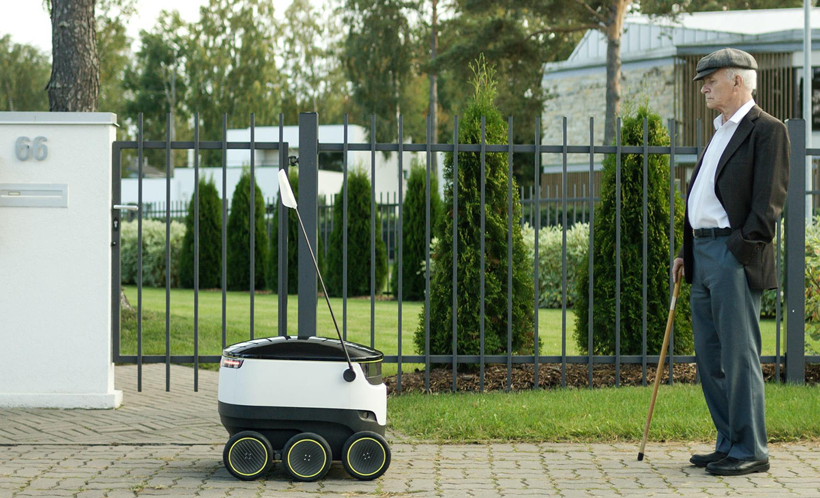
The future is for all
Bridging the digital gap: Look@World
A private initiative cultivated digital citizens
Trained 10% of Estonia's adults,
reaching even rural areas with
IT trainings on wheels etc
Initiated projects like e-School
Daily, 2000 librarians offer
e-service guidance, helping
people to become skilled
Notes:
Vaata Maailma has distinguished itself as a crucial private initiative for elevating digital literacy across Estonia. Notable projects like e-School and 'Ole Kaasas!' bus courses stand testament to their innovative approach. Their efforts have educated 10% of Estonia's adult populace and set new standards for IT education both in schools and remote areas.
Allikad:
Vaata Maailma: https://all-digital.org/vaata-maailma/
Ole Kaasas! Bus Trainings: https://www.bcskoolitus.ee/projekt/ole-kaasas-bussikoolitused/
Wikipedia: https://et.wikipedia.org/wiki/Vaata_Maailma

Slide 18
Too small to fail.
Countries like Estonia are like a wild animal
– constantly on the alert, and forced to innovate.
Taavi Kotka
Estonia’s CIO 2013–2017
Notes:
18

Slide 19

Aitäh!
Photos: Renee Altrov, Aron Urb, Sven Zacek,
Küllike Heide, Lauri Kadajane, Aivo Kallas, Tallinn University, Ajujaht
educationestonia.org
Notes:
19

