Slide 1

Vocational Education in Estonia

Slide 2





VET. Accessible in every county
30
25 500
students
vocational education
institutions
25 state
3 private
2 municipal
institutions
5
2121
professional higher education institutions
teachers & teaching professionals
Notes:
VET is accessible in every county
(Data: 2024)
Vocational education can be acquired in vocational education centres. In few cases also in professional higher education institutions
Schools can be owned by state, local municipality or be based on private funds
Most of vocational education studies are school-based, but all programmes include compulsory practical training/internship in company

Slide 3
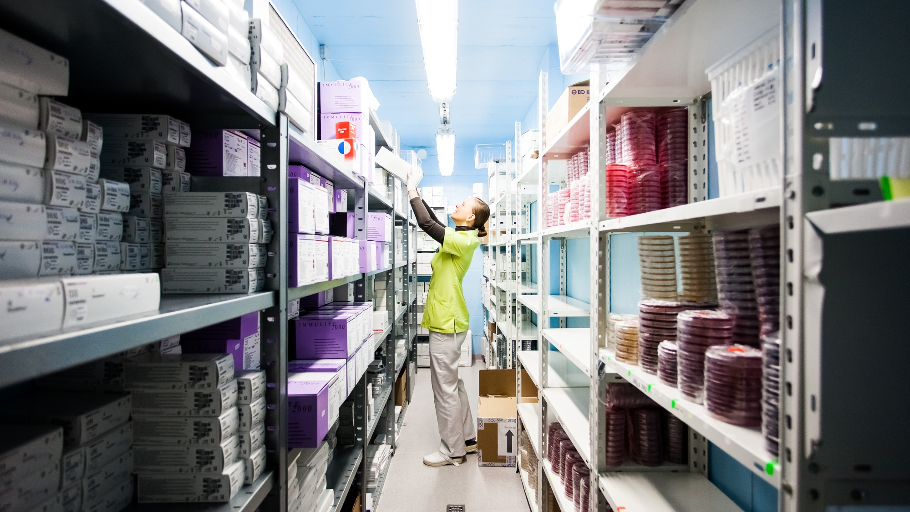
VET education.
Practical, flexible and available
The state has special project (OSKA) to ANALYSE THE LABOUR MARKET to find out what skills are needed in the future.
Much of vocational education consists
of WORK-BASED LEARNING, allowing students to better prepare for the job market.
Close COOPERATION WITH THE PRIVATE SECTOR provides students real workplace experience.
Access to VET programmes and additional training is free for all ages.
With over 130 specialities to choose from, Estonian vocational education offers a comprehensive range of options.
Flexible study formats offer wide range of possibilities, including full-time, part-time, and distance learning.
Notes:
Vocational education institutions offer vocational education and training as well continuing education and courses for adults, regardless of how old someone is.

Slide 4
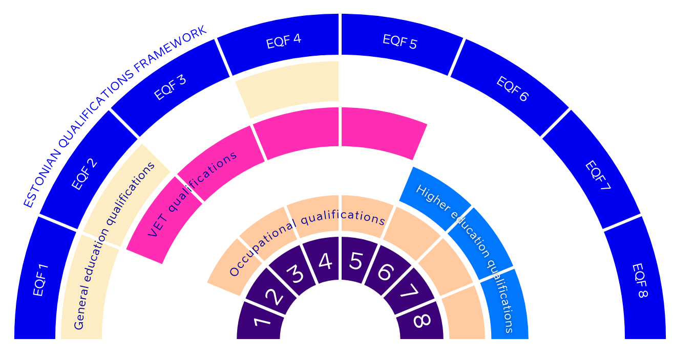
VET curricula is directly driven by professional standards
Notes:
Professional standards are used for designing VET curricula, curricula for higher education and other training programmes, for assessing learner competences, and awarding a professional qualification. They:
are based on a job analysis and describe the nature of work; analyses are carried out by working groups designing professional standards;
describe expected competences as observable and assessable;
define the method(s) for assessing learner competences and a 'satisfactory' threshold;
define qualifications (EQF) levels.
All professional standards are available in the State register.
VET qualifications
Uniform requirements for VET curricula and qualifications are stipulated by the VET standard ( 48 ). The standard:
describes the requirements for national and school curricula and the curriculum groups in line with ISCED levels, their objectives and expected learning outcomes;
determines the terms and conditions for recognising prior learning, volume of study and graduation requirements by initial and continuing VET curricula;
defines requirements for teachers and trainers;
assigns the national qualifications framework levels to VET qualification types.
VET schools design curricula for every qualification offered.
Upper secondary VET programme curricula that give access to higher education are based on the national curricula. National curricula are based on professional standards, the VET standard and the national (general education) curriculum for upper secondary schools. Foundation Innove coordinates the process of curriculum design, including cooperation with social partners.
Other VET curricula are based on the VET standard and the respective professional standard(s). Where such standards do not exist, the school must apply for the curriculum to be recognised by social partners.
The vocational orientation curriculum (legal framework introduced in 2018) is not required to correspond to a certain professional standard. This facilitates transitions from compulsory education to VET and/or the labour market, especially for vulnerable groups.
The education minister approves national upper secondary VET curricula that give access to higher education.
(Cedefop)

Slide 5
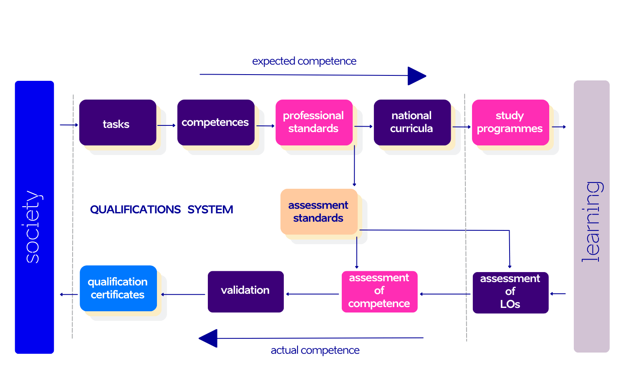
Competence circle
Graph: Estonian Qualifications Authority

Slide 6
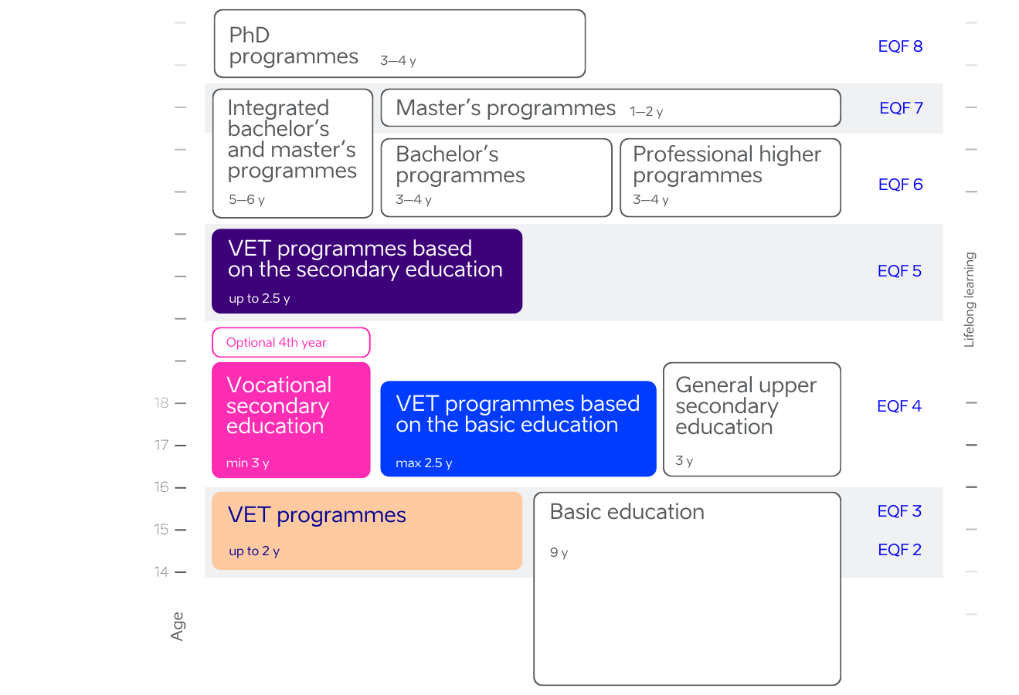
Flexible learning possibilities
Notes:
Biggest share of students are studying at the level 4.
Vocational secondary education gives access to higher education (level 6)
The Vocational Educational Institutions Act distinguishes between initial and continuing VET.
Source: Cedefop and ReferNet Estonia.
While both types provide the knowledge, skills and attitudes necessary to enter the labour market, initial VET also gives learners access to the next qualification level. Non-formal continuing VET is part of adult learning regulated by the Adult Education Act.
Formal VET leads to four qualification levels (2 to 5) that are the same as in the European qualifications framework (EQF). The VET standard specifies the volume (number of credits), learning outcomes, conditions for termination and continuation of studies for each VET type.
There are several VET learning options:
school-based learning (contact studies, including virtual communication with the teacher/trainer);
work practice (practical training at school and in-company practice);
self-learning (excludes work practice; at least 15% of a programme should be acquired through autonomous learning; if it exceeds 50%, the programme is considered to be 'non-stationary'; 21% of VET learners were in 'non-stationary' programmes in 2020/21, mostly at EQF levels 4 and 5).
Apprenticeships were introduced to VET as a stand-alone study form in 2006.
Source: Cedefop and ReferNet Estonia.
Upper secondary VET learners receive two qualifications simultaneously: an upper secondary education qualification and a professional qualification verifying learning outcomes for a specific occupation or profession.
To complete a VET programme, learners need to pass a professional qualification examination, if available. That can be replaced by a final examination if unsuccessful in the professional qualification examination. Both examinations are learning outcomes based and usually include a practical part.
In addition to VET examinations, State examinations (mother tongue, mathematics and foreign language) are available for upper secondary VET graduates as an option. They are organised centrally by the Education and Youth Authority (Cedefop).

Slide 7
Basic education graduates choices EHIS 2022
www.haridussilm.ee/ee/valdkonnaraportid/haridus/kutseharidus

Slide 8
Students
Notes:
Haridussilm, Oct 2023

Slide 9
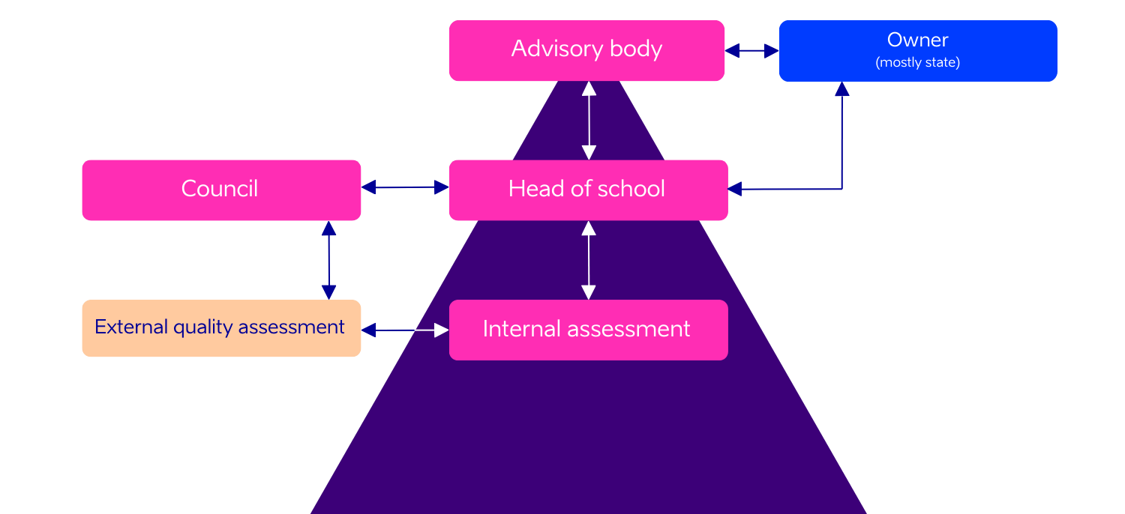
Management of VET schools
Notes:
The advisory body is a body of advisors connecting the school and society and the function of which is to advise the school and manager of school upon planning the development and organisation of teaching and education and economic activities.
The highest collegial decision-making body of the school is the council, the function of which is to organise the activities and plan the development of the school.
The head of the school execute the highest administrative and disciplinary power at school within the limits of his or her competence; bear liability within the limits of his or her competence for the general state, teaching and education, development activities and for legitimate and purposeful use of financial resources and assets of the school;
The advisory body is connecting the school and society (representatives of local government and enterprises ect), the function of which is to advise the school and owner of school upon planning the development and organisation of teaching and education and economic activities.
The highest collegial decision-making body of the school is the school council, the function of which is to organise the activities and plan the development of the school.
The council shall include: the head of school, employees, student representatives ect.
External assessment, based on an internal assessment, conducted by external independent assessors once in every six years. In the course thereof the performance and sustainability of teaching and education, including the development of curriculum, learning and teaching, leading and management and the use of resources shall be evaluated. The assessment of quality shall be organised by the Education and Youth Authority. The membership of the assessment council shall include: experts appointed by the body of chairmen of professional councils, representatives of employers’ central organisations and other interested parties, representative of vocational educational institutions,pupils’ representatives.

Slide 10

Funding model
80–95%
Basic funding
School performance indicators
% of students graduated from
the professional examination
% of students participating
in apprenticeships
% of vocational secondary education graduates
% of students studying further
or employed
10–20%
Grants
for
students
Performance based funding
Notes:
Since 2018, a new model for financing vocational education was introduced, which no longer proceeds solely from the number of State-commissioned student places. Instead, the school, its activities and performance will be financed as a whole.
The new financing model consists of basic financing and performance-based financing. This secures the budgetary stability of the management and HR expenses of schools.
Basic financing considers the number of learners, the areas taught, the salary rates of teachers, the specific features of specialties, students with special needs, the need for support specialists, and the buildings used by the school. Basic financing is fixed for 3 years and guarantees the funds required for the main activities of the schools.
Performance-based financing, which values the outstanding achievements of schools, is based on performance indicators, which comply with the strategic goals important to the State. These include the share of students who graduate after the nominal period of study, the share of graduates who go further in their learning or participate in employment, the share of students who graduate by taking a professional examination, and the share of students participating in apprenticeship training. One of the ideas behind performance financing is to guarantee that vocational schools have the funds they need for cooperating with companies and general education schools. Performance financing will comprise up to approximately 20% of the money the school receives from the State budget.
A few privately financed VET programmes are available in State-owned and municipal VET schools. Such programmes are usually in high demand (as with cosmetician programmes) but are not part of the State-financed programmes.
Apprenticeships are also co-financed by ESF.
State and municipal vocational schools may provide continuing training for adults for a fee without age restrictions. They can also attract additional financing from other sources, such as international projects. (Cedefop)

Slide 11
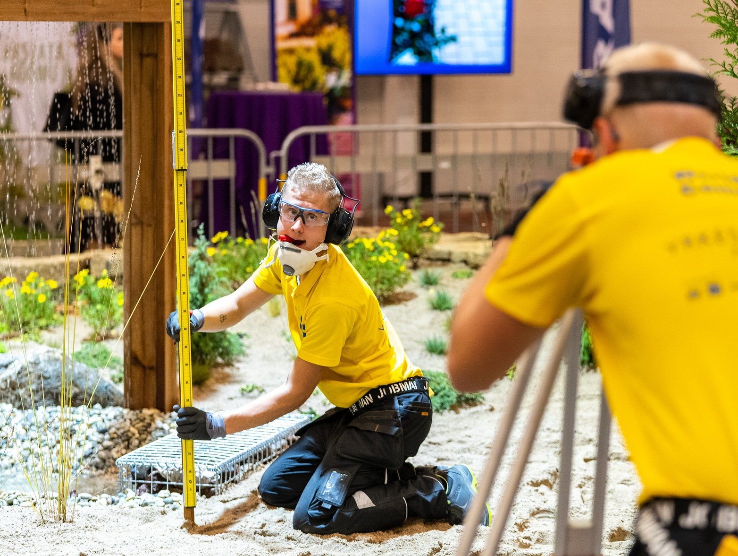
Quality assessment
Internal evaluations for quality control and improvement
External evaluations to align with national educational standards
Incorporating feedback from students and employers for curriculum development
Notes:
Internal and External Evaluations: Vocational schools undergo both internal and external evaluations to ensure quality. Internal evaluations are conducted by the schools themselves, focusing on continuous improvement. External evaluations are carried out by the Estonian Quality Agency for Higher and Vocational Education to ensure compliance with national standards.
Student and Employer Feedback: An essential part of the quality assessment process involves gathering feedback from both students and employers. This feedback is used to make necessary adjustments to the curriculum and teaching methods, ensuring that the education provided is both high-quality and relevant to the job market.
Source: HAKA
VET quality is assured through external and internal processes that do not differentiate in their approach between school-based learning, work-based learning, self-learning (including 'non-stationary') and apprenticeships.
External quality assurance
External quality assurance of schools' curriculum groups is confirmed by awarding the 'right to offer VET programmes'.
Following changes in the approach to learning and teaching, the approach to quality assurance (i.e. external assessment process) was changed in 2019. The former extension of the right to provide instruction based on the accreditation results in the curriculum group was replaced with a permanent right to provide instruction in curriculum groups, where schools have accreditation for the full period (six years).
The external assessment is organised by the Quality Agency for Higher and Vocational Education (EKKA). A quality assessment in curriculum groups will take place once in 6 years and the result of the assessment is not directly connected with the right to provide studies. The process is more focused on achieving constant improvements in the teaching and learning process and the development of quality culture at school.
An assessment of the right to provide instruction, giving a school this right for a term of 3 years, shall be conducted in curricula groups, and repeated if necessary, by 31 August 2022. The minister responsible for the area shall make one of the following decisions:
to grant the right to provide instruction without a term;
to grant the right to provide instruction for three years;
not to grant the right to provide instruction.
A school that has received the right to provide instruction in a curriculum group for a specified term, in order to obtain the right to provide instruction without a term, should submit an application for a repeat assessment, together with the internal assessment report, at least 6 months before the expiry of the right to provide instruction. Schools that have received the right to provide instruction in a curriculum group for a specified term, but have not submitted an application to the Ministry of Education and Research, or if the minister responsible for the area makes a decision not to grant the right to provide instruction as a result of the repeat assessment, shall have its right to provide instruction terminated upon the expiry of the term.
Internal evaluation
In 2006, internal evaluation of education institutions became mandatory, the objective being to support the development of VET providers. VET providers regularly (formally at least every three years) conduct an internal evaluation of each curriculum group and draft a report. EKKA consults them on this process.
The internal assessment shall form the basis for preparing the development plan of a school and the assessment of quality. The internal evaluation criteria are similar to those for external evaluation: leadership and administration; resource management (including human resources); cooperation with interest groups; and education process. Methods of internal evaluation are chosen by VET providers. They often use activity and performance indicators provided in the education statistics database HaridusSilm.
The education information system collects data about the internal evaluation and feedback reports, so the ministry is able to check whether internal evaluations have been conducted and supported by advisory services. The results of internal evaluations are public but education institutions are not obliged to make them available on their websites.
EKKA provides free counselling to VET schools that support self-assessment and internal evaluation reporting.
(Cedefop)

Slide 12


Competitions drive excellence
Strategic tool for improving vocational education quality
The chance to test and develop students skills in
a professional environment
Enhance the attractiveness of vocational fields among young people
EuroSkills
2023
WorldSkills
2022
EuroSkills
2021
Photo: EuroSkills 2021 silver medalists
Notes:
Skill development and assessment: Competitions offer students an invaluable opportunity to put their skills to the test, develop them further, and have them assessed in a professional setting. These competitions highlight the practical value of vocational education and help students gain a deeper understanding of the demands and opportunities associated with their chosen fields.
Popularising vocational education: Competitions such as "Noor Meister" and other international skills contests serve to elevate the status of vocational education. They play a crucial role in making vocational fields more appealing to young people, thereby boosting enrolment rates.
International collaboration: International platforms like EuroSkills and WorldSkills offer a venue for global cooperation. They provide Estonian students and educators with the opportunity to interact with and learn from their counterparts in other countries. Success in these international arenas serves to enhance Estonia's reputation in the field of vocational education on a global scale.

Slide 13
OSKA: Bridging skills and labour market needs
ADDRESSING KEY QUESTIONS:
How many people and which skills
are needed in our labour market today and tomorrow?
Where and how to aquire those skills?
What should be changed to meet the future needs?
THE RESULTS OF ANALYSIS ARE USED AS:
  input to the qualification and career counselling system
  curriculum development of educational institutions
  financing of educational institutions (allocation of study places)
Notes:
The lack of information about labour market needs is one of the main problems in professional education. OSKA is a coordination system for the monitoring and forecasting of the labour market needs and the development of skills by the Estonian Qualification Authority (from2014).
OSKA surveys the needs for labour and skills, together with professional standards, to help people make informed career choices.

Slide 14

Navigating the challenges
NEET rate among 18-24y is 9.8%
High drop-out rate in VET
The share of boys is much higher
among low achievers and secondary education dropouts.
Differing paths in secondary education are not equally valued.
Do we need common upper secondary education standard?
Lack of qualified vocational educators and specialists

Slide 15
Vocational education reform
to enhance VET's appeal to better align with future trends, expand choices after graduation, and ensure a longer-lasting skill set.
CURRICULUM REFORM
SCHOOL NETWORK REFORM
NEW VET LAW
in 2024
Extended study duration
New concept for secondary education
Emphasis on
cross-disciplinary skills
Comprehensive, individualised curricula
Practical skill assessments
Regional education centers to provide wide range of learning pathways
Competency-based division of schools
New funding mechanisms
Makes changes
to start reforms
New VET Law for 2027 to perpetuate the new concept

Slide 16

Legal framework
Vocational Educational Institutions Act
Standard of Vocational Education
National Curricula, EstQF 4,
upper secondary VET, Ministerial regulations
ISCED F-2013
Professional standards

Slide 17
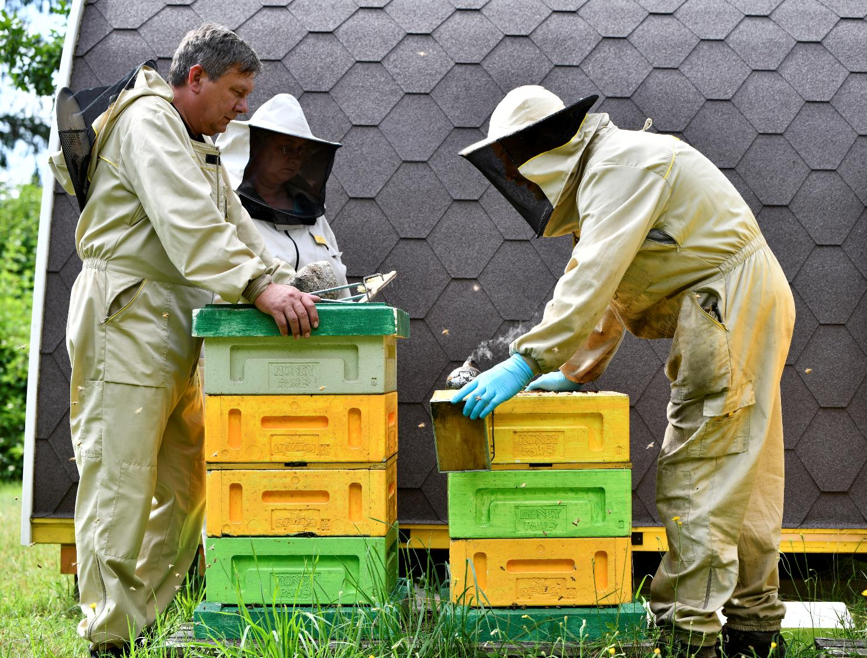
Aitäh!
Photos: Küllike Heide, Lauri Kadajane, Marek Metslaid
Notes:
17

