Slide 1
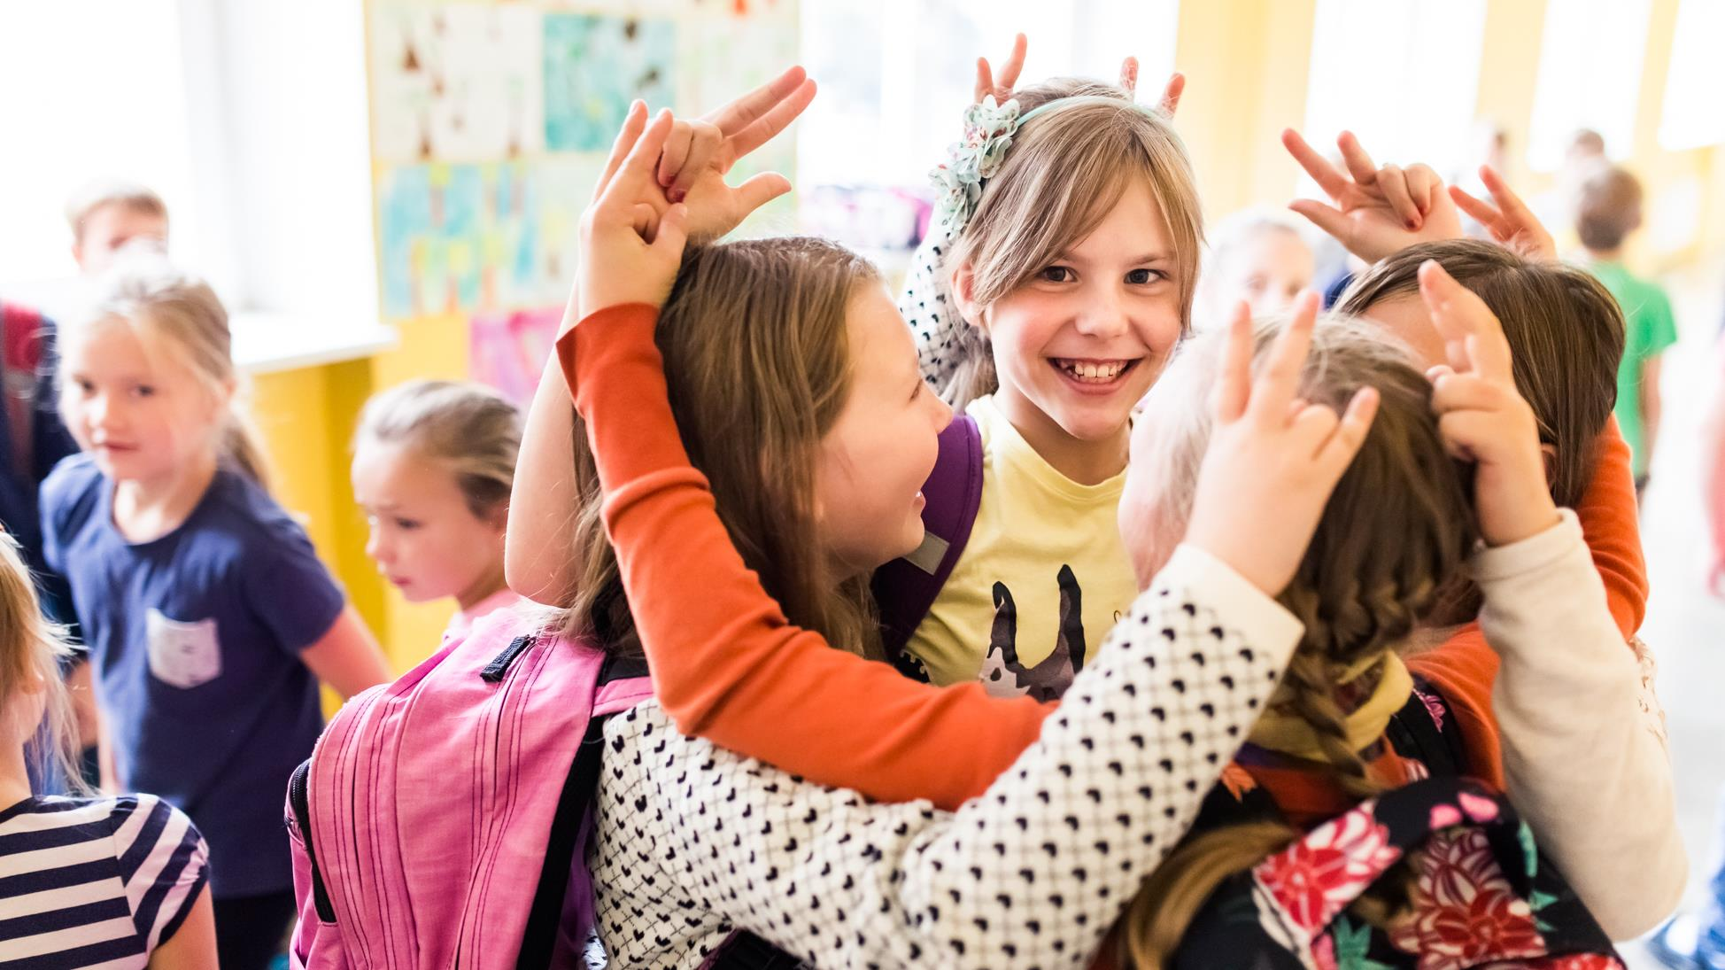
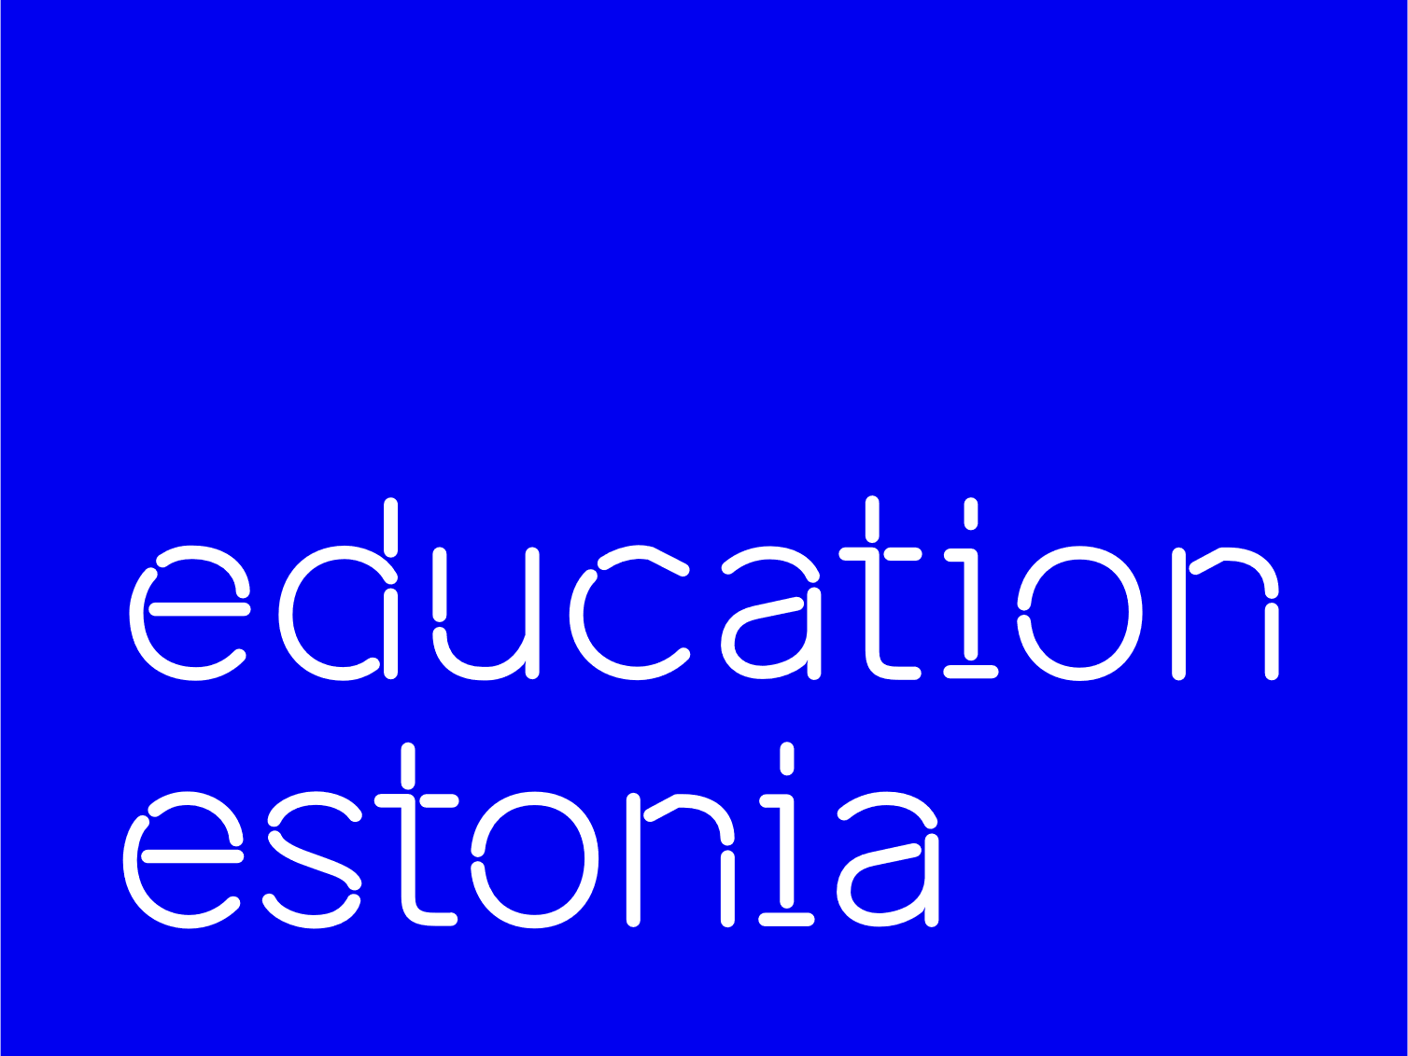
Estonia.
Smart solutions for education innovation

Slide 2

Estonia
population: 1.3 million
45,339 km2
EU, NATO member (since 2004)
99% of public services online

Slide 3
Estonian students at the top in Europe
PISA 2022
 | MATHEMATICS |  | READING |  | SCIENCE
1 | Estonia | 510 | Ireland | 516 | Estonia | 526
2 | Switzerland | 508 | Estonia | 511 | Finland | 511
3 | Netherlands | 493 | UK | 494 | Ireland | 504
4 | Ireland | 492 | Finland | 490 | Switzerland | 503
5 | Belgium | 489 | Denmark | 489 | Slovenia | 500
6 | Denmark | 489 | Poland | 489 | UK | 500
7 | UK | 489 | Czech Republic | 489 | Poland | 499
8 | Poland | 489 | Sweden | 487 | Czech Republic | 498
9 | Austria | 487 | Switzerland | 483 | Latvia | 494
10 | Czech Republic | 487 | Italy | 482 | Denmark | 494
1st in science
1-2 in reading with Ireland
1-2 in mathematics with Switzerland

Slide 4
PISA 2022: Estonia in comparison with top performers and neighbouring countries

Slide 5
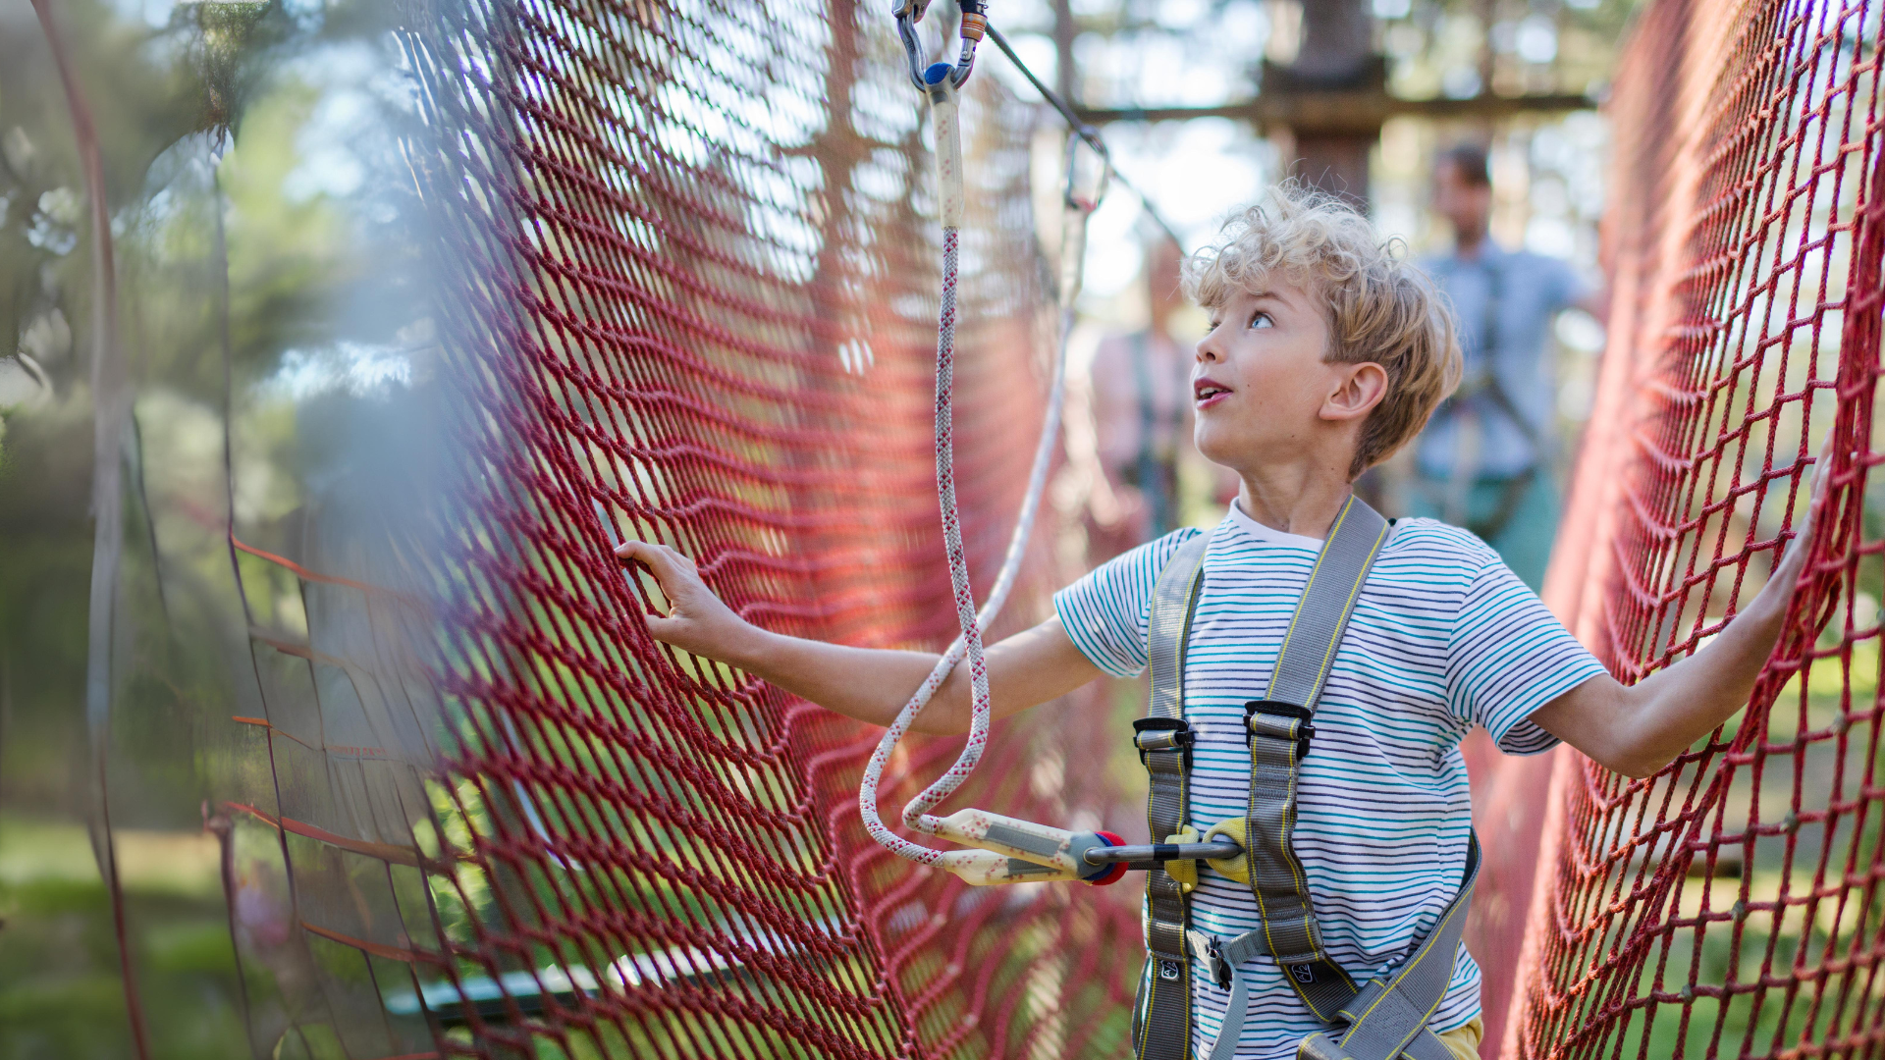

Estonian student
according to PISA 2022
Students are self-directed in their learning,
feel secure in their school environment,
are taught by teachers with the most freedom to shape learning.
1st
1st
globally
in growth mindset
in Europe
in creative thinking

Slide 6
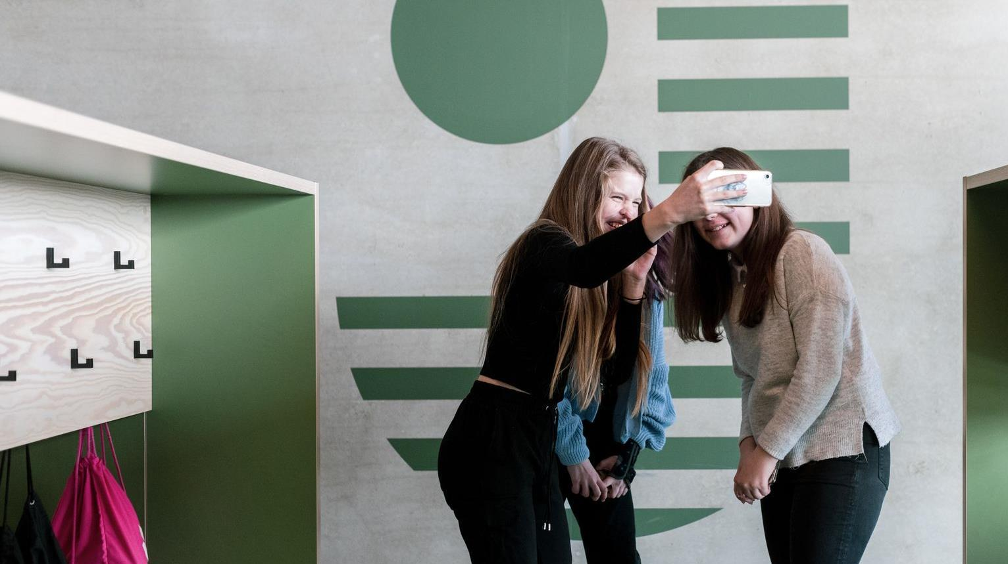








HIGHLY EDUCATED TEACHERS
STRATEGY & DATA
Master's degree in school,
Bachelor’s in kindergarten
Data-driven governance and joint strategic goals
Key
qualities
of Estonian
education
system
AUTONOMY
Autonomy of schools
and teachers
EARLY EDUCATION
Most 4-6-year-olds attend kindergarten, even though
it's not mandatory
INCLUSIVE EDUCATION
Special support for those requiring it and programmes for the gifted
EDUCATION IS
FREE-OF-CHARGE
QUALITY OF EDUCATION
HOBBY EDUCATION
is endorsed by internal evaluation surveys, and external assessment of learning outcomes.
offers wide opportunities for additional education and self-development
from basic to higher education, including school meals,
textbooks
Notes:
HIGHLY EDUCATED TEACHERS. Estonian teachers are highly educated, requiring a master's degree to work as a teacher and a bachelor's degree for a kindergarten teacher. Estonia has a culture of trusting and empowering teachers. The curriculum only sets the results that children should know by the end of school, while teachers decide how to achieve those results. Parents and the state trust teachers to make the best decisions for their students.
AUTONOMY: Every school creates their own curricula on the basis on national curriculum. principals can decide on teachers salaries and how the money is spent etc, teachers are free to decide how they reach learning outcomes set in curricula
Estonia has an INCLUSIVE EDUCATION SYSTEM. Students with different abilities study together. All students are entitled to free SPECIAL SUPPORT from psychologists and speech therapists at school or the counselling centres found in every county.
EDUCATION IS FREE-OF-CHARGE from basic to higher education. School meals, textbooks, and transit are free for all students.

Slide 7
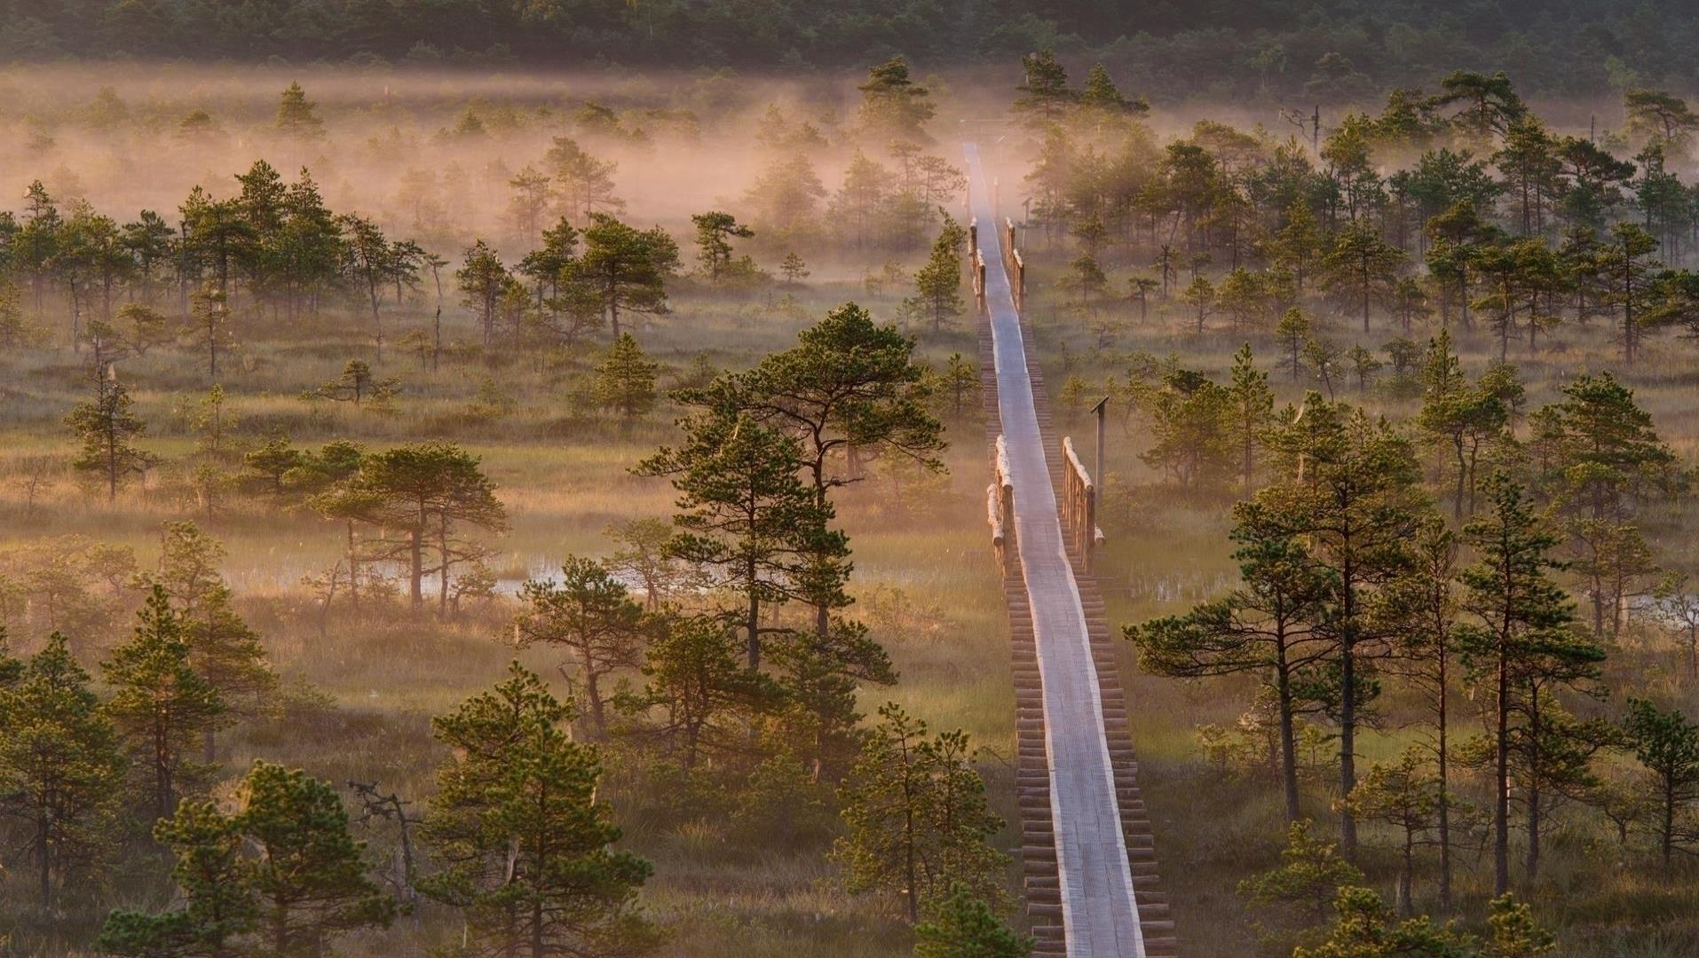
Education has been
highly valued through generations
Before 1918
Under Danish, Swedish, German, Russian rule
13th c. First monastic schools
17th c. Schools for peasant children
1860-70s Compulsory school
1881 Literacy rate 94%
1918-1940
Estonian Republic
1944-1991
Soviet Occupation
Start of the Estonian
national education system.
From 1920 compulsory and
free education for 6 grades.
Estonia managed to maintain
high-quality teaching and learning
in Estonian.
1991
Republic of Estonia
The modernisation of Estonian education begins.
Notes:
Estonia's educational system is older than the country itself. Education in the native language came first, followed by the educational movement in the 19th century. This led to the creation of the state.
Educational mindset has always been both a guarantee of individuaal success and one of the main drivers of the country’s development. Work hard and aim high mindset is still prevalent among Estonian students.
Literacy rate – the ability to read was one of the highest rates in the world at that time and triple compared to the average in Russian empire. "Compared with the huge Russian empire, to which Estonia belonged at the time, the level of literacy here was immeasurably higher: according to the 1881 census, 94 per cent of the population could read and 48 per cent could read and write." Estonica.org

Slide 8

Restart of the education system
A state database EHIS brings together all information related to education in Estonia
VOCATIONAL EDUCATION REFORMS start build a flexible and practical system relevant to the needs of the labor market
EXTERNAL QUALITY ASSURANCE
of education
All SCHOOLS CONNECTED TO THE INTERNET and provided with computers
1992
1996
1999
2002
1994
1997
2001
2004
TIGER LEAP programme provided schools with computers, internet access, and teacher training
1999-2009
Harmonising HIGHER EDUCATION
with European standards:
recognition of diplomas
3 main study cycles
scholarships for mobility
accreditation system
internationalisation
E-SCHOOL -
web application for schools provides
an easy way for parents, teachers, and pupils to share information
NATIONAL CURRICULUM
for general education with the focus
on learning outcome, decentralisation, and school autonomy
THE LAW ON EDUCATION of the Estonian Republic
sets general principles
Notes:
The slides provide an overview of a selection of important educational reforms and initiatives since the 1990s
Additional info:
The TIGER LEAP PROGRAMME started the digitalisation of the entire public sector in Estonia. In few years, Estonia became the first country in Europe to provide stable internet connection to all schools. www.educationestonia.org/tiger-leap/
The NATIONAL CURRICULUM for general education has been updated regularly afterwards (2002, 2011, 2014)

Slide 9
Optimising school network: building of regional
STATE GYMNASIUMS begins
New education STRATEGY 2035
focused on self-directed learner
FREE LUNCH in basic school.
From 2014 also in
upper secondary school
Establishment of Rajaleidja SUPPORT CENTRES NETWORK with offices in every county
2024-2030
Transition to Estonian language education
2005
2010
2012
2015
…
2006
2011
2014
2020
2024
Requirement to DIGITIZE ALL LEARNING MATERIALS by 2020
Future skills forecasting programme OSKA to link learning more effectively with labour market needs
INCLUSIVE EDUCATION
as a leading principle
BOOSTING
TECH EDUCATION ProgeTiger &
IT Academy programmes.
Engineering Academy in 2023
PROFESSIONAL STANDARDS FOR TEACHERS create the conditions for systemic teacher education responsive to the needs of society
More variability to educational landscape: Founding PRIVATE SCHOOLS becomes easier
Raising compulsory
education age to 18

Slide 10
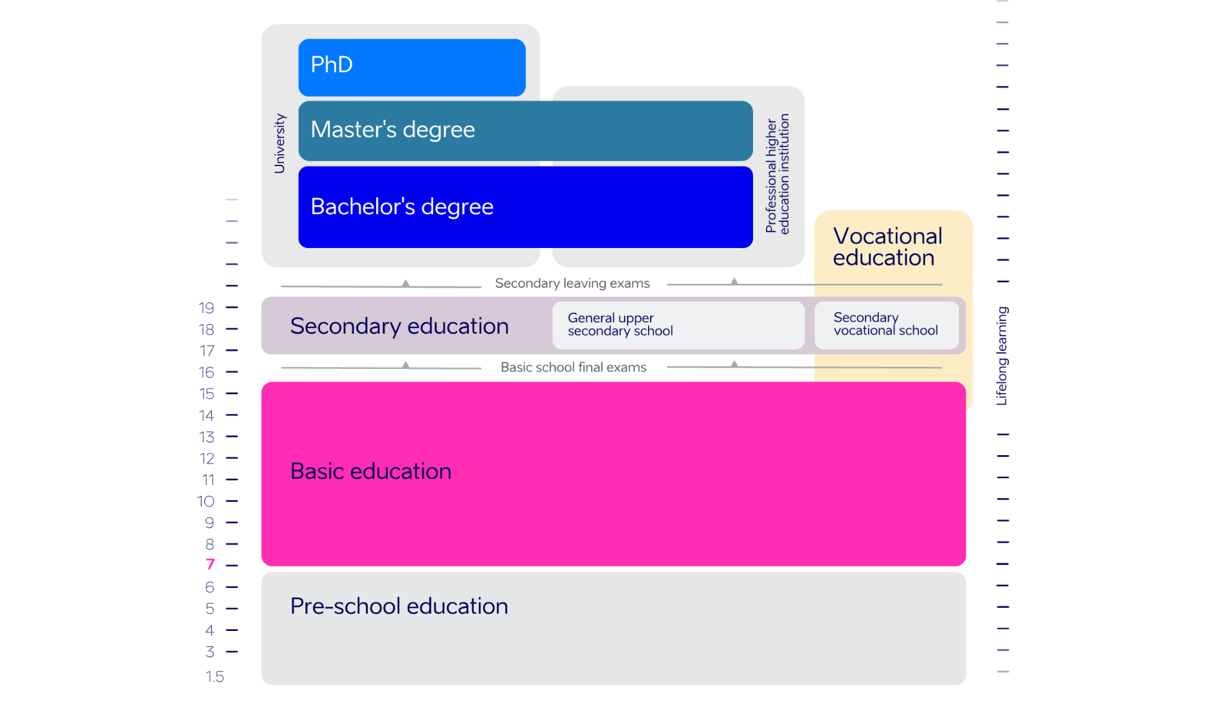
General education:
171,000
students
17,500
teachers
510
schools
Schools
are mainly
municipal
6%
state
schools
11%
private schools
Notes:
Data source: haridussilm.ee Oct 2024
Basic education is minimum compulsory general education. Compulsory education starts at the age of seven and lasts from grades 1 to 9.
In general education, schools are mostly run by local governments. There are ≈ 11% of private schools in Estonia. In both cases, the number of students is used to calculate the amount of state subsidies allocated for covering expenses on teachers’ salaries, training and textbooks.

Slide 11
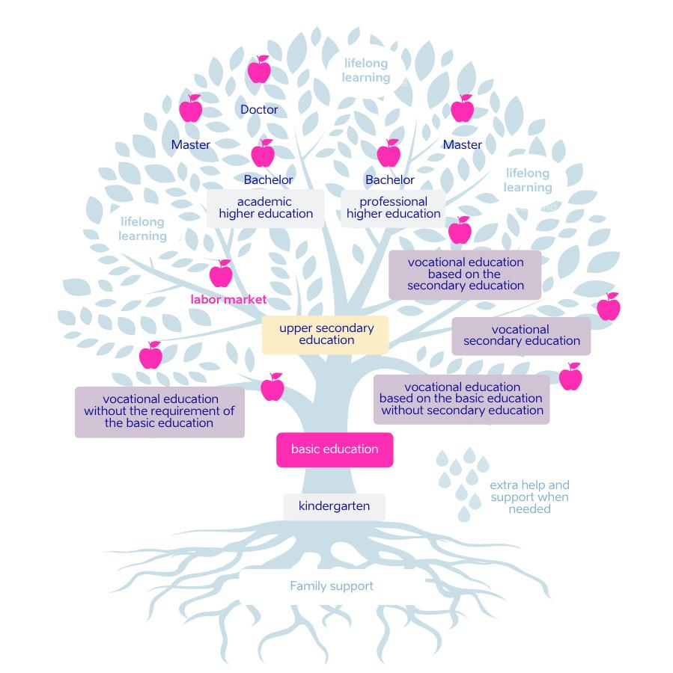
The strength of the tree depends on its roots
Estonia has a comprehensive school system: all children get the same education
from grades 1–9.
Notes:
Family and society strongly support education.
The first streaming happens after grade 9. Students can still always switch paths.

Slide 12
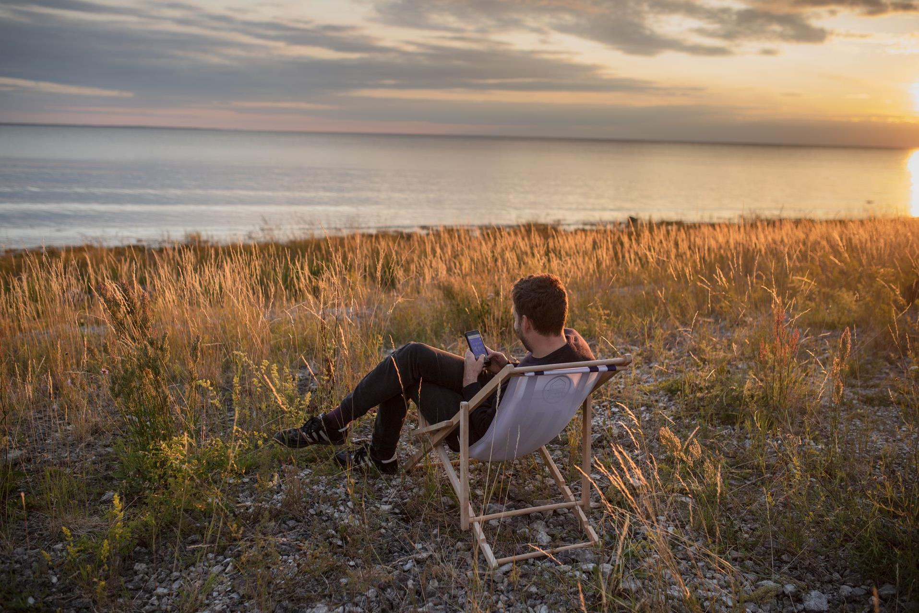

Estonia – digital nation
1st
2nd
in Europe for startups
and unicorns per capita,
1452 startups and 10 unicorns,
Atomico 2022
in Internet Freedom,
Freedom House 2023
1st
1st
in Digital Public Services,
DESI 2022
in the world for Digital Learning, CEPS 2019

Slide 13
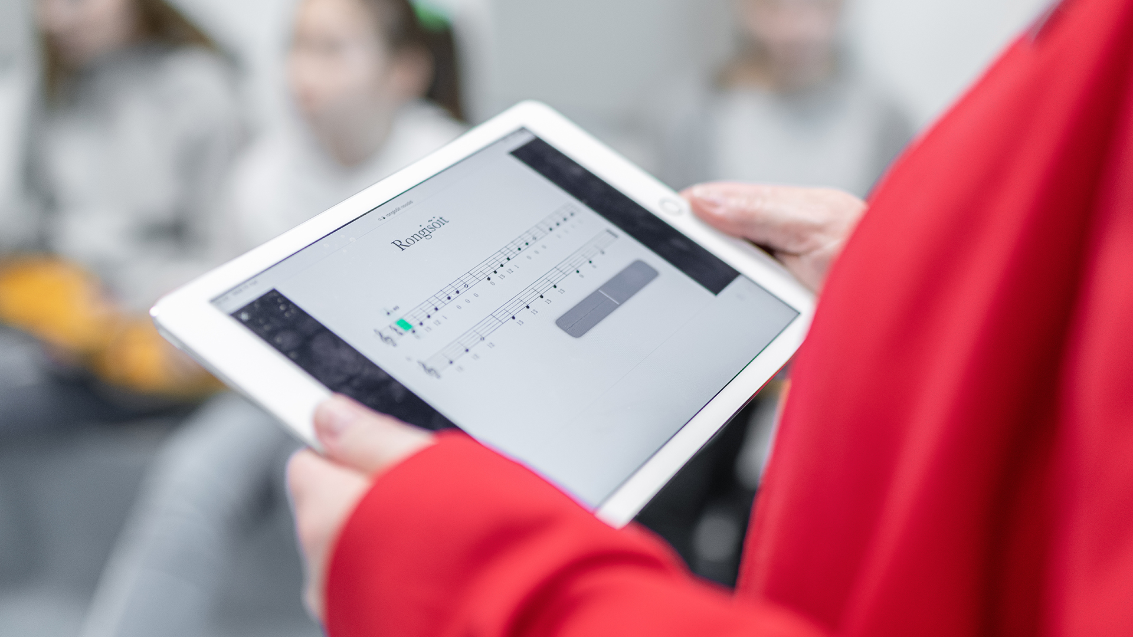
Digital solutions are in everyday use
E-diaries for schools and kindergartens: Eliis, eKool, Stuudium
Digital learning materials and platforms: e-Schoolbag, OPIQ
Student admission systems: DreamApply, SAIS
Examination Infosystem EIS for digital tests
Estonian Education Infosystem EHIS
Notes:
13
Since the introduction of the E-DIARY PLATFORM EKOOL IN 2002, digital tools have been seamlessly integrated into education. The government has invested in the infrastructure of schools to provide access to high-speed internet, allowing more seamless integration of digital tools and materials in the classroom.

Slide 14
The numbers
Estonia’s tech education
99%
1in3
of Estonian kindergartens
take part in technology education programme ProgeTiger
students pursues STEM
in higher education
9%
40%
of students study ICT
in Estonia (BA+MA) –
twice as many as EU average
Eurostat 2018
of ICT Master’s students are female – this is highest share in Europe Informatics Europe 2020
Notes:
99% of kindergartens and 98% of schools took part in ProgeTiger programme, Education and Youth Board 2020
8.86% of all students studied ICT (BA+MA) in Estonia, while EU average is 4.65%, Eurostat 2018
2019/2020 40% of ICT Master students were female in Estonia, www.informatics-europe.org
1st in digital learning - CEPS (Centre for European Policy Studies) assessed European countries’ performance in digital learning and found that Estonia, the Netherlands and Finland excel in the digitalisation of education. www.educationestonia.org/estonia-no-1-in-europe-for-digital-learning/

Slide 15
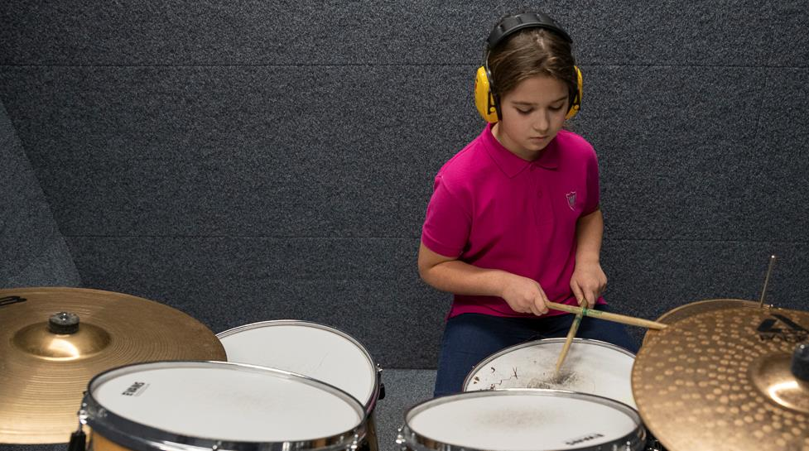
80% of the
7-19 year olds participate in hobby education or hobby activities
Notes:
15
Source: The Ministry of Education and Research
- HM tulemusaruande analüütiline osa, 2022, https://www.hm.ee/sites/default/files/documents/2023-08/2022_TA_anal%C3%BC%C3%BCtiline_lisa.pdf

Slide 16
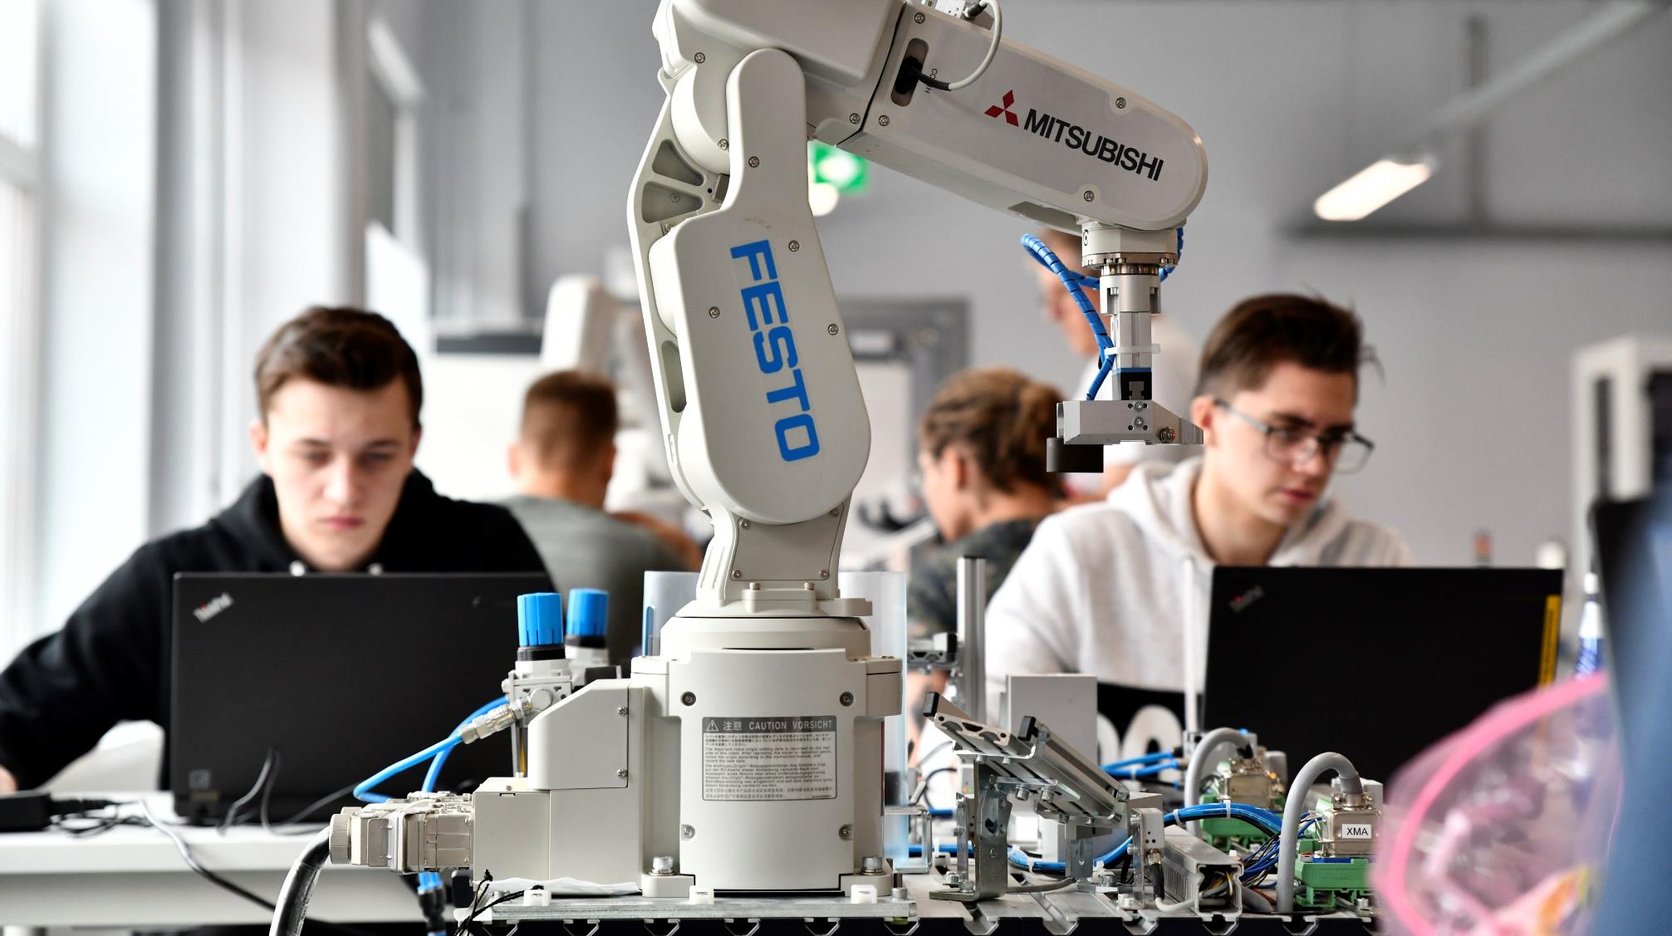
Vocational education: ensuring essential skills
VOCATIONAL EDUCATION has flexible forms of studies.
The state has special project (OSKA) to ANALYSE THE LABOUR MARKET to find out what skills are needed in the future.
Close COOPERATION WITH THE PRIVATE SECTOR provides students real workplace experience during their studies.

Slide 17
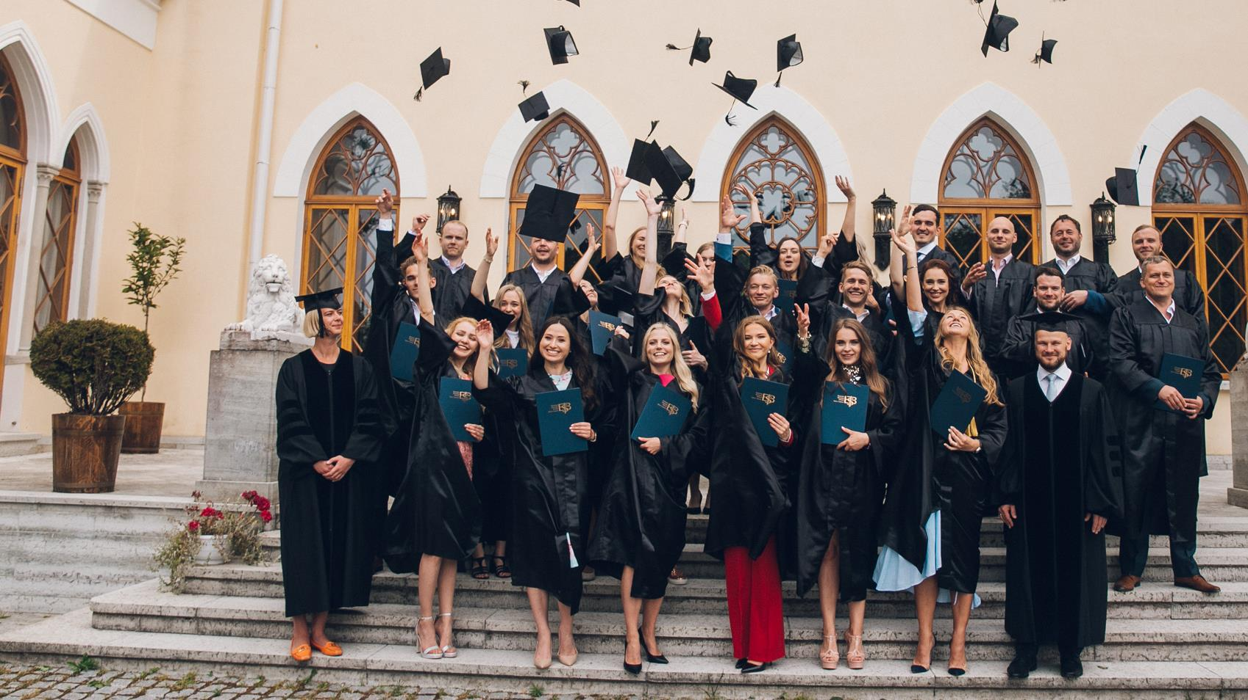
Internationally acknowledged higher education
Estonian universities rank high
in prestigious ranking systems such as THE and QS
Innovative study programmes: e-governance, cybersecurity etc
Student projects from self-driving car to space satellite
Over 150 degree programmes fully taught in English,
in 11 internationally accredited universities
Internationally recognised diplomas
World-class research projects
Notes:
17
THE – Times Higher Education World University Rankings, www.timeshighereducation.com
QS - QS Quacquarelli Symonds World University Rankings, www.topuniversities.com

Slide 18
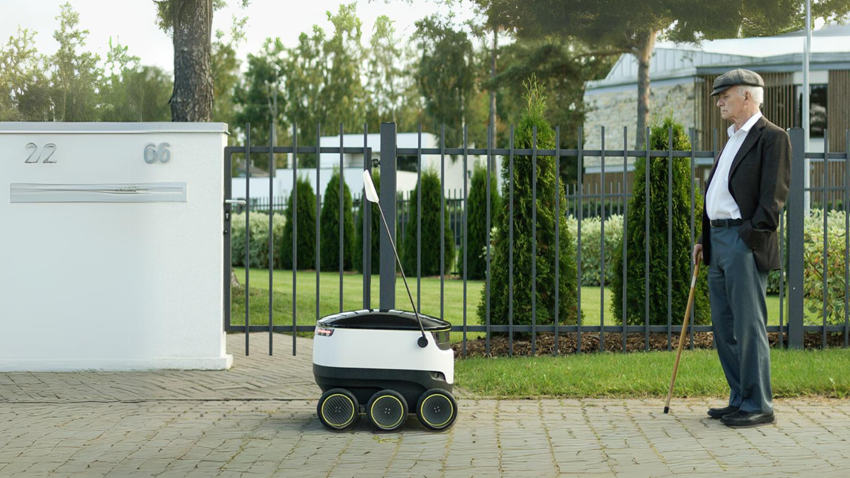
Lifelong learning has become a lifestyle in Estonia
Estonians within the
25-64 age group actively participate in learning
at almost double the rate
of the EU average
(21% vs 12%, Eurostat 2022).
Notes:
Acquiring new skills, retraining, and completing unfinished schooling are popular: Estonian adults within the 25-64 age group actively participate in learning at almost double the rate of the EU average (21.1% vs 11.9% - Eurostat 2022).
Source: https://ec.europa.eu/eurostat/statistics-explained/index.php?title=Adult_learning_statistics

Slide 19
We truly think that the best thing we can give to our children is not land, house or a bank account, but good education.
T. H. Ilves
T. H. Ilves, the former president of Estonia
Notes:
19

Slide 20
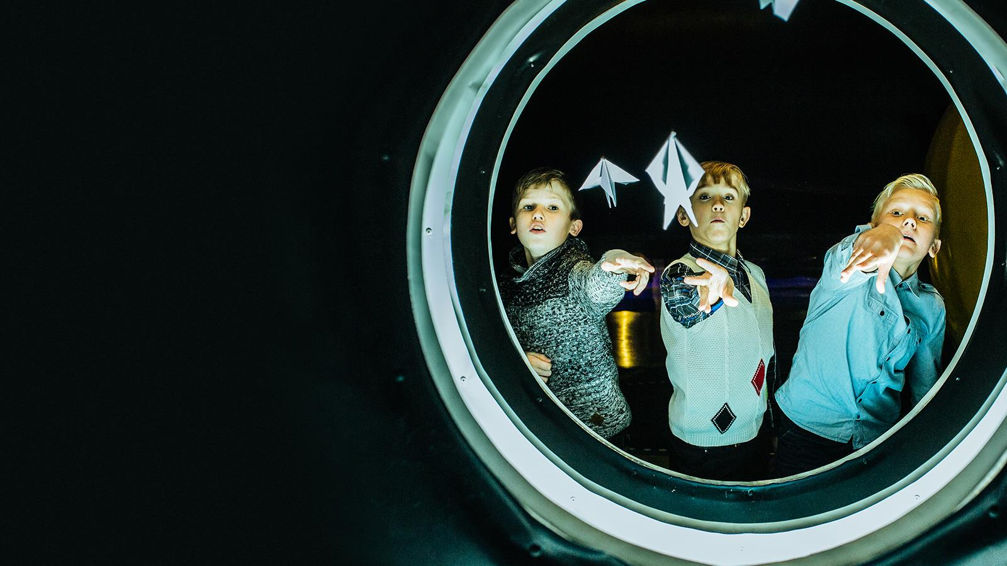

Aitäh!
Photos: Renee Altrov, Aron Urb, Sven Zacek,
Küllike Heide, Lauri Kadajane, Aivo Kallas, Estonian Business School, Ajujaht
educationestonia.org
Notes:
20

Slide 21

Read me!
To make your presentation look good, make sure you have
the official Estonia Aino font installed.
If not, download and install the font separately HERE.

